Slide 1


Slide 2
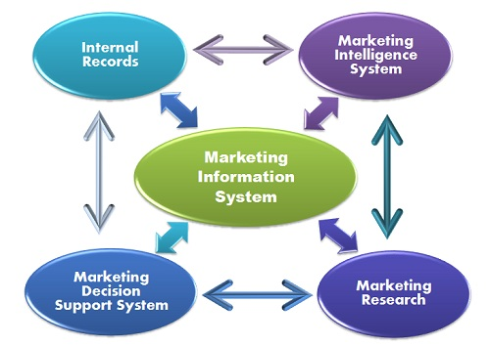
Marketing Research and Marketing Information System (MkIS) comparison
Marketing Research Process Marketing Information System
Data used is primarily external Data can be external or internal
Main function is solving problems Can solve problems + prevent problems through controls
Projects handled on project Operates as continuous system to project basis rather than intermittently
Information focus on present Projection techniques facilitate and past data attaining future orientated data
Process provides one source of System includes variety of sub- information for decision making systems (one in mktg research)
Commitment can be sporadic due Total organisational commitment to project-to-project basis secures best efficiency

Slide 3


Marketing Research defined
'Market' research is research into a specific market. It is a narrow concept
'Marketing' research is broader. It includes market research as well as areas like new product research; new modes of distribution such as via the Internet.
American Marketing Association definition
Marketing research is the function that links the consumer, customer and public to the marketer through information that is used to identify and define marketing opportunities and problems;
to generate, refine, and evaluate marketing actions;
to monitor marketing performance;
to improve understanding of marketing as a process.
Marketing research specifies the information required to address these issues, designs the methods for collecting information, manages and implements the data collection process, analyzes, and communicates the findings and their implications

Slide 4
Marketing Research Issues
Monitoring existing products - market size; brand shares; consumer behaviour; brand switching; distribution performance
Research for market planning - forecasting ‘STEEPLE’ factors and their influence on markets; assessment of company and competitor SWOT; corporate and brand image studies; assessing PLCs and NPD; segmentation studies
Researching the marketing mix - optimising four Ps using ad-hoc + continuous research
Sources - Secondary/desk; primary
Survey design - Exploratory (secondary sources, trade/consumer interviews); Conclusive (qualitative and quantitative)
Duration of survey - Ad hoc; continuous - panels; omnibus
Data collection - postal/personal questionnaire; telephone; depth interview; street survey; observation; mechanical - tachistoscope/ psychogalvanometer; structured/unstructured

Slide 5

Why MkIS is needed
Increased complexity of business calls for more information and MkIS input to MIS is invaluable
PLCs tend to be shorter - more skill needed to attain optimum profits, thus need for information
Marketing has become a complex activity so planning needs current information through MkIS
In large business it is important that key data is centralised and not dispersed
Decision making increasingly relies on speedily available information
Changing role of selling means sales-force can increasingly gather market intelligence
IT advancements have made this possible

Slide 6
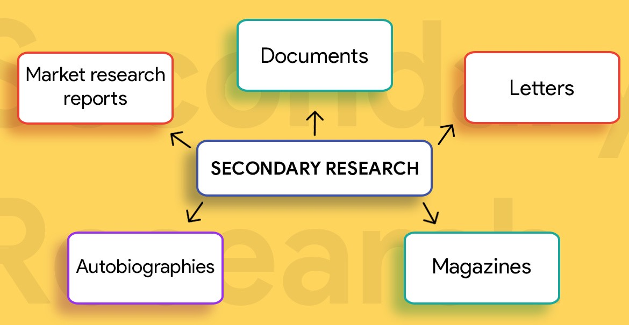
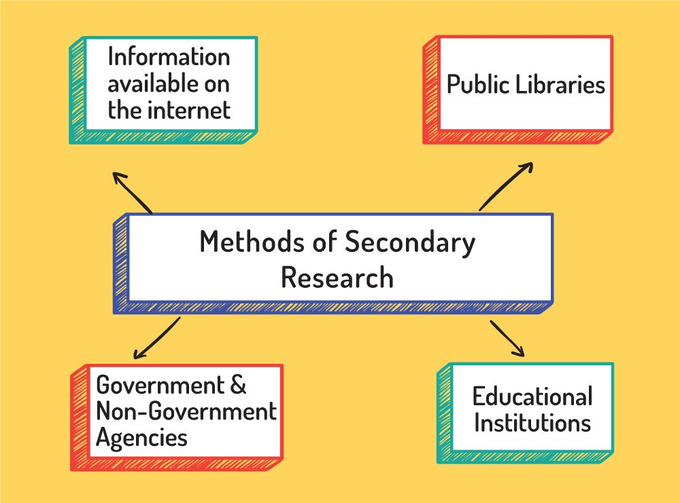

Secondary (or desk) research uses data that has been
collected for other objectives than your own
i.e. it already exists. Example of sources:
Trade associations
National and local press Industry magazines
National/ international governments
Web sites
Informal contacts
Trade directories
Published company accounts
Business libraries
Professional institutes and organisations
Omnibus surveys
Previously gathered marketing research
Census data
Public records
Secondary Research

Slide 7


Marketing Research Do's
Marketing research gives information you need to make the right business decisions. Do not underestimate its significance
Define what you want to know, and work out what you want to find out and from who;
Beware of bias. Survey respondents will want to please you and will follow your lead;
Insights are different to information. Information provides raw data, not insights

Slide 8

Marketing Research Dont's
A ‘don’t know’ option is better than forcing a respondent to answer incorrectly;
Don’t fail to get the audience you are researching right – ensure they represent your universe;
You don’t have to spend a lot on good marketing research. DIY tools (e.g. Survey Monkey) can gather useful information effectively, quickly and affordably.

Slide 9


Marketing Research pros & cons 1
Advantages/Reasons to Use Secondary Data:
1. Helps clarify or redefine definition of the problem as part of exploratory research process
2. It may actually provide a solution to the problem
3. It may provide primary data research method alternatives
4. It might alert researcher to potential problems to be encountered in research process (e.g. sample selection, response bias experienced by other researchers, potential lack of cooperation)
5. It can provide necessary background and build creativity into planning of research report.
Limitations of Secondary Data:
A. Lack of Availability - required data may be unavailable.
B. Lack of Relevance - available data may be expressed in units or measures that cannot be used by researcher.
C. Inaccurate Data - previous researchers may have published data containing errors that may distort research results.

Slide 10


Marketing Research pros & cons 2
Popularity of Qualitative Research (reasons)
a) Cheaper to conduct than quantitative research (usually)
b) Understanding of in-depth motivations may be gained
c) Results may improve efficiency of subsequent empirical research
d) Combining techniques usually improves overall research effectiveness
Limitations of Qualitative Research
a) Does not always detect small differences in a marketing mix (or in anything else)
b) The results are not necessarily representative of the population of interest (due to small sample size and/or using a non-probability sample)
c) Researchers in the field without good formal training can seriously bias results, even if accidentally

Slide 11


Marketing Research pros & cons 3
Advantages of Observation Research
1) Avoids bias caused by interviewer and/or questionnaire structure in survey research
2) Researcher sees what people do rather than relying on what they say they did
3) Research not plagued by problems associated with lack of response by subjects who are unwilling or unable to respond
4) Some forms of data can be gathered more quickly by observation, saving time and money
Disadvantages of Observation Research
1) Only behaviour can be examined. Thus unable to learn about motives, attitudes, intentions, or feelings which cannot be measured directly by observations alone
2) Current observed behaviour may bear no relation to future behaviour
3) Might be time-consuming and costly

Slide 12
The Internet as a marketing research tool
The Internet can be used to collect primary data. Visitors to sites can be asked to complete electronic questionnaires. Responses will increase if incentive is offered such as free newsletter or free membership. Other important data is collected when visitors sign up for membership.
Advantages of the Internet
Relatively inexpensive
Uses graphics and visual aids
Random samples can be selected
Visitors tend to be loyal to particular sites and are willing to give up time to complete the forms
Disadvantages of the Internet
Only surveys current, not potential customers.
Needs knowledge of software to set up questionnaires and methods of processing data
May deter visitors from your website

